Slide 1

Bright coffee shop sales
Bolalane Palesa Seoka
27 October 2025

Slide 2



Agenda
Introduction
Overview of approach
Key insights from data
Visualizations

Slide 3

Introduction
The Bright Coffee Shop Sales Analysis is prepared to provide valuable business insights using historical transactional data. This analysis is conducted to support the newly appointed CEO in making informed decisions to grow the company's revenue and enhance product performance.
As a Junior Data Analyst, my role has been to extract actionable insights from the available sales data, focusing on understanding which products generate the most revenue, identifying the best-performing sales time slots, and uncovering trends across products and time intervals.
This presentation will share the key findings from the analysis, visualized through charts and pivot tables, and offer recommendations aimed at improving overall sales and operational efficiency.

Slide 4
Overview of approach
The approach involved a structured data flow starting with raw sales data collection, followed by processing and transformation using SQL in Snowflake for cleaning, grouping, and calculating key metrics. The processed data was then exported to Excel for detailed analysis and visualization using pivot tables and charts.
This methodology allowed us to identify revenue-generating products, peak sales times, and sales trends by product and time intervals. Various tools including SQL platforms and Excel were used to ensure efficient data handling and clear presentation of insights to support strategic decision-making.

Slide 5
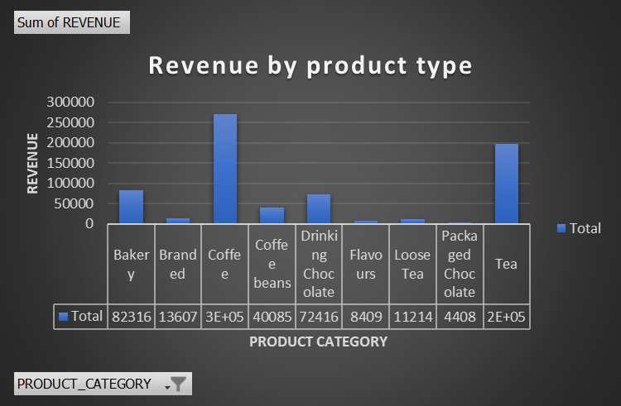
Visualizations
Coffee is the best-selling category with a significant lead, totaling 45,158 sales.
Tea and Bakery products are also popular, with 35,078 and 18,140 sales, respectively.
Categories like Drinking Chocolate, Flavours, Coffee Beans, and Branded products have lower sales, suggesting room for growth or reevaluation.

Slide 6
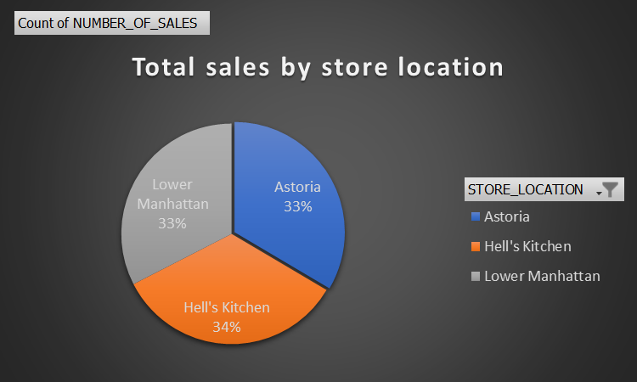
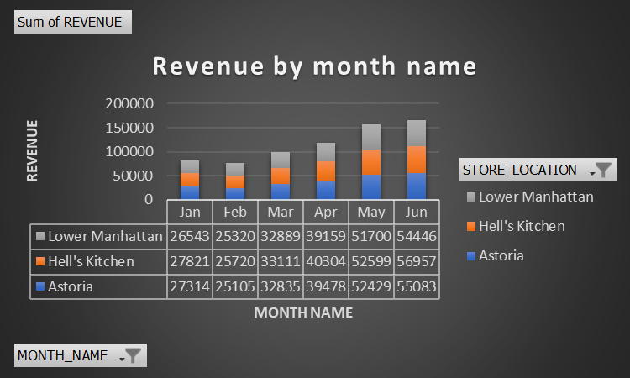
Visualizations
Strong Overall Revenue Growth: Total monthly revenue shows a consistent, significant upward trend from January through June, nearly doubling over the period. This indicates strong scaling and successful business performance.
Hell's Kitchen and Astoria Lead: The Hell's Kitchen and Astoria locations are the dominant revenue generators, consistently contributing the highest amounts and driving the overall increase
Lower Manhattan's Surge: While starting lowest, the Lower Manhattan store showed the most pronounced proportional growth in Q2, specifically surging from May to June ,demonstrating high potential for future growth.

Slide 7
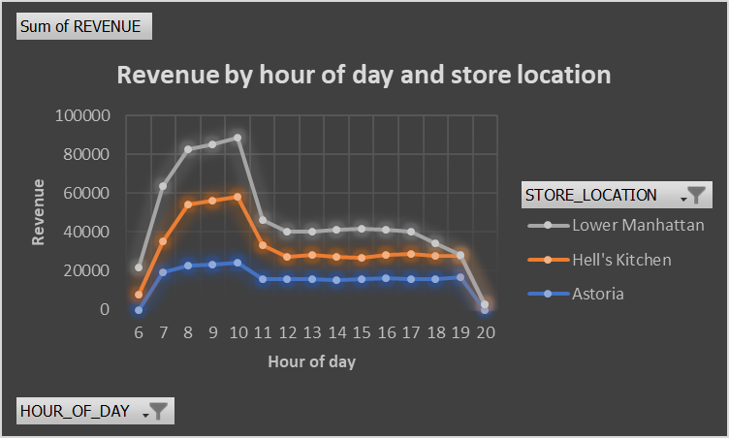
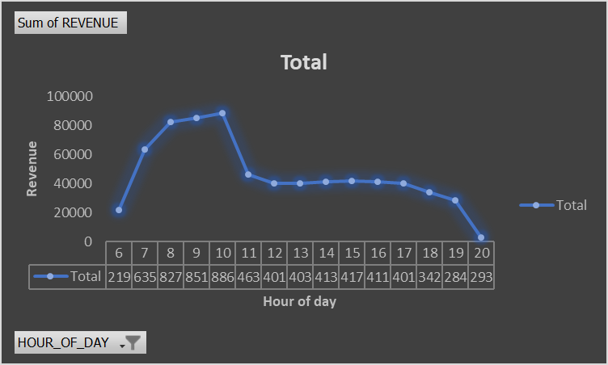
Visualizations
Peaking Revenue Hours : Revenue demonstrates a dramatic surge in the early morning, peaking between 8 AM and 10 AM. The maximum revenue point occurs at 10 AM (R88,646), followed closely by 9 AM (R85,188) and 8 AM (R82,746). This identifies the late morning as the primary revenue driver.
Sustained Mid-Day Plateau: Following the 10 AM peak, revenue drops significantly but then enters a long, stable plateau lasting from 11 AM (approx. R46K) through 5 PM (approx. R40K). This sustained period of moderate revenue indicates consistent mid-day operations, likely covering the lunch and early afternoon sales.
Sharp Evening Decline: Revenue begins a steady decline after 5 PM, with a steep drop-off after 7 PM. Revenue hits its lowest point at 8 PM with only R2,930, signaling that sales effectively cease or are minimal after 7 PM.

Slide 8
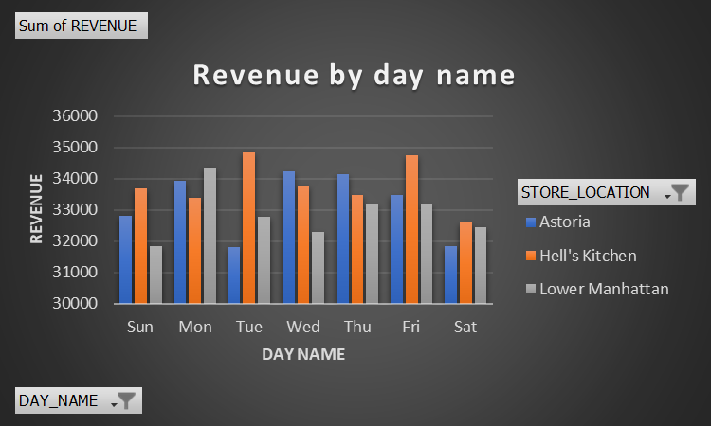
VISUALIZATIONS

Slide 9
Thank you
Bolalane Palesa Seoka
Bpseoka2001@gmail.com
27 October 2025

